Slide 1
Assessing Toronto's Neighborhood to Open Chinese Restaurant
Atekelt K.
December 2019

Slide 2

Background
Toronto is the most populated, multicultural and multiracial Canadian city.
Demography ( 2016):
Population- Above 2.8 Million
Density -4,149.5 people per square kilometer (10,750/sq mi)
Chinese community has 12% share (more than other cities of Canada)

Slide 3
Cont.….
Business Description:
Many Chinese restaurants in Toronto city but not evenly located asper Chinese community density magnitude
There are considerably high potential costumers for Chinese restaurant
The business can be more profitable , when it opens at optimal location
The Question : Where the Chinese restaurant should be located to yield more profit?
The Hypothesis: To make the Chinese Restaurant business profitable better to open it in the neighborhood with no or limited Chinese restaurant and with more Chinese residence.

Slide 4
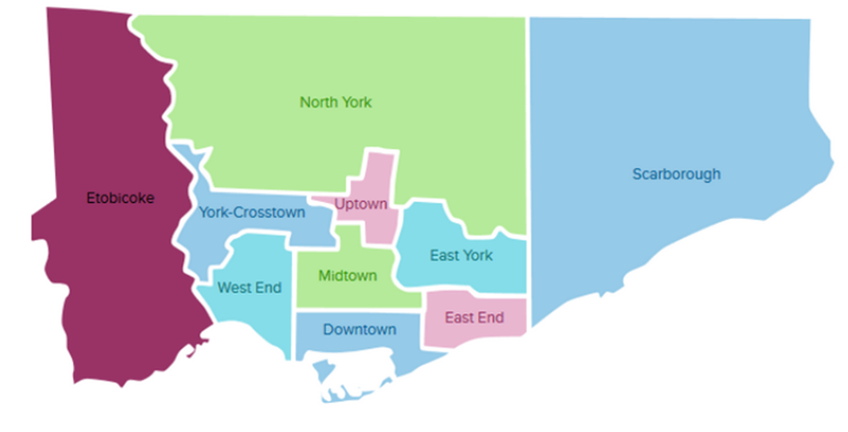
Data acquisition
List of Postal code :the postal code, borough and the name of all the neighborhoods in Toronto
Geospatial data: the geographical coordinates of the neighborhoods.
Demographics of Toronto: the distribution of population by their ethnicity
Venues detail in Toronto : extracted using Four square’s API:
Figure 1: Toronto city’s Boroughs

Slide 5
Methods and Materials
Understand and described the business problem properly is the crucial stage to identify the methods and materials adopted
Selection of reliability Data sources
Data Acquisition and Preparation using Python
Data analysis using Python
K-mean Clustering Model development using Python
Visualization with Python
Select the best place to open the Chinese restaurant

Slide 6
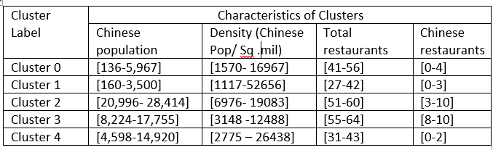
Results
A total of 118 Chinese restaurants were explored
106 Chinese restaurants were found only at North York and Scarbought boroughs.
The K-mean Clustering outputs are characterized as:

Slide 7
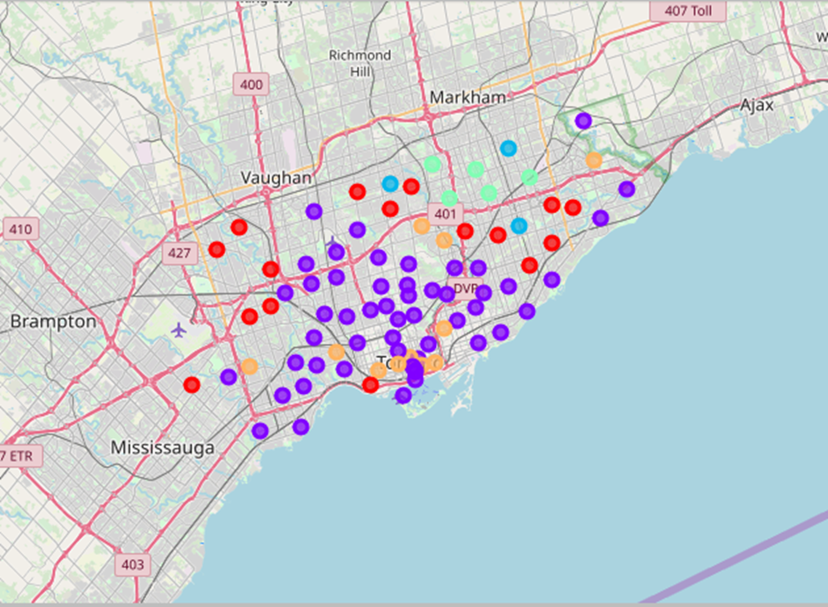
Cont.…
Figure 2: Clustered map of Toronto, Canada (input: latitude, longitude ,Neighborhood ,Clustering label ,Chinese restaurants ,Chinese population). Cluster-0: Red, Cluster 1: Purple, Cluster-2: Light Green, Cluster -3: Light Blue, and Cluster-4: Orange

Slide 8
Cont….
Important findings:
Chinese population size of 14,921 live in Etobicoke Borough (Specifically at: Cloverdale, Islington, Martin Grove, Princess Neighborhood) without Chinese restaurant in their vicinity ( labeled in Cluster 4).
Chinese population size of 10,000 live in Downtown Toronto Borough ( specifically at : Harbourfront Neighborhood )without Chinese restaurant in the nearby.
In comparison with others considerably larger Chinese population are living in these boroughs in the absence of Chinese restaurants.

Slide 9
Cont….
Important findings:
Chinese population size of 14,921 ( density =14,937) live in Etobicoke Borough (Specifically at: Cloverdale, Islington, Martin Grove, Princess Neighborhood) without Chinese restaurant in their vicinity ( assigned in Cluster 4).
Chinese population size of 10,042 ( density=25,823)live in Downtown Toronto Borough ( specifically at : Harbourfront Neighborhood )without Chinese restaurant in the nearby (assigned in Cluster 4).
In comparison with others considerably larger Chinese population with their density are living in these boroughs in the absence of Chinese restaurants.

Slide 10
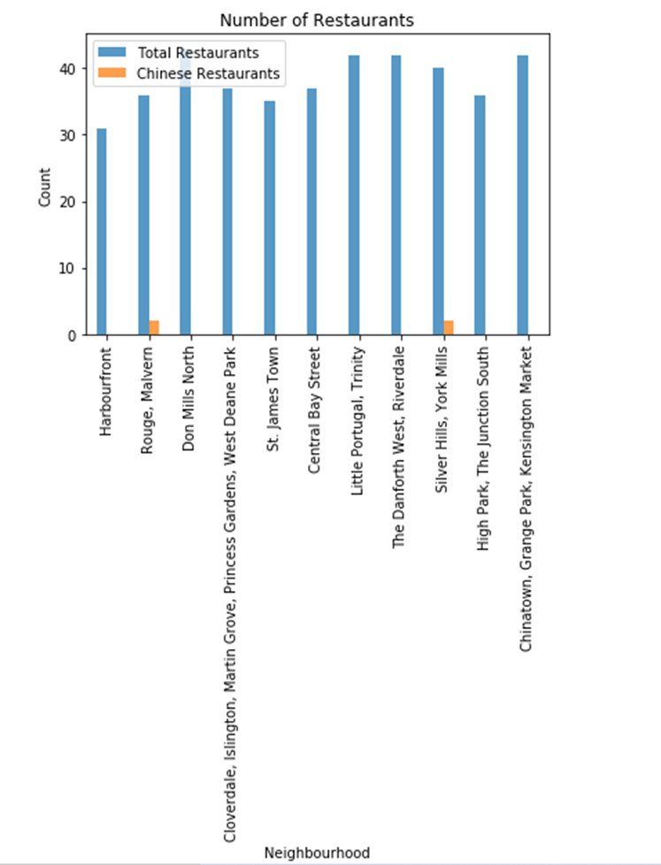
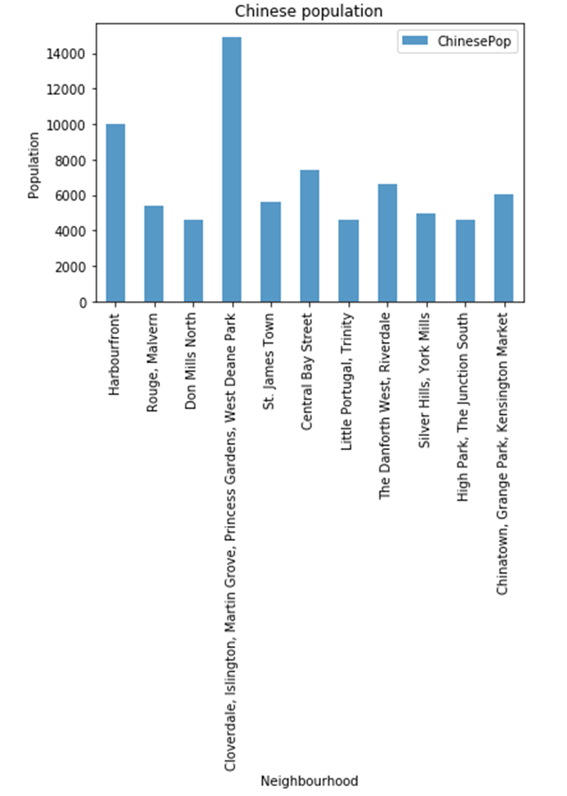
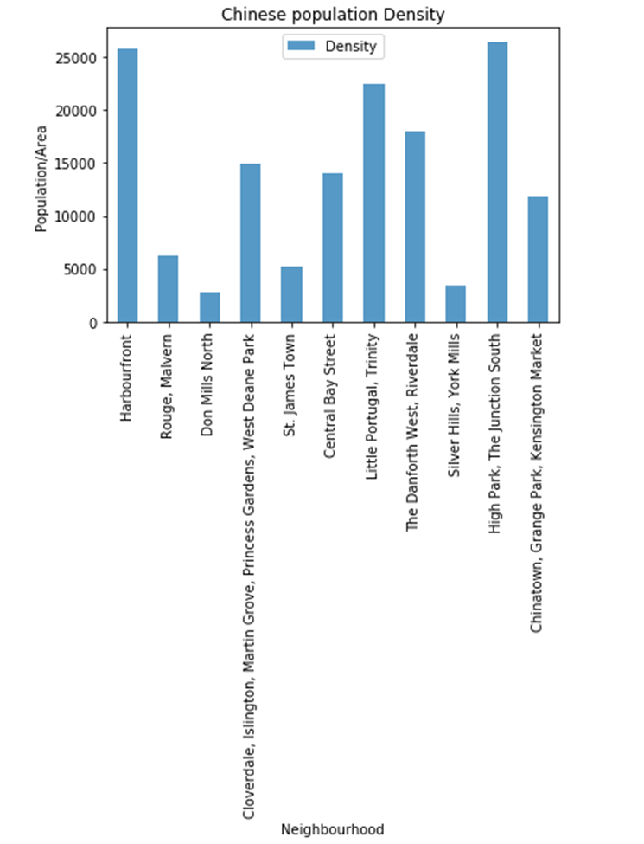
Detail analysis results of Cluster-4

Slide 11
Discussion
Two potential locations for Chinese restaurant were identified using clustering algorism, such as :
Cloverdale, Islington, Martin Grove, Princess Neighborhoods in Etobicoke borough
Harbourfront Neighborhood in Downtown Toronto Borough
Both locations have considerably large and dense Chinese population (potential customers)
9 Chinese restaurants are existed at 3 different neighborhoods in Etobicoke borough, that serves 27,085 Chinese population in the borough
No Chinese restaurant in the entire Downtown Toronto Borough , while the total Chinese Population in the brough is 36,4250 (good potential)

Slide 12
Conclusion
From the result , I concluded that Downtown Toronto Borough, specifically Harbourfront Neighborhood is the best location for the investors to open Chinese Restaurant.

